Slide 1




Emotion Awareness: Dimensions of Trust in Software Engineering
It Will Never Work in Theory: Live! April 2023
Dr. Preetha Chatterjee Assistant Professor
SOftware Engineering and Analytics Research (SOAR) Lab Drexel University, USA
preetha.chatterjee@drexel.edu @PreethaChatterj https://preethac.github.io

Slide 2
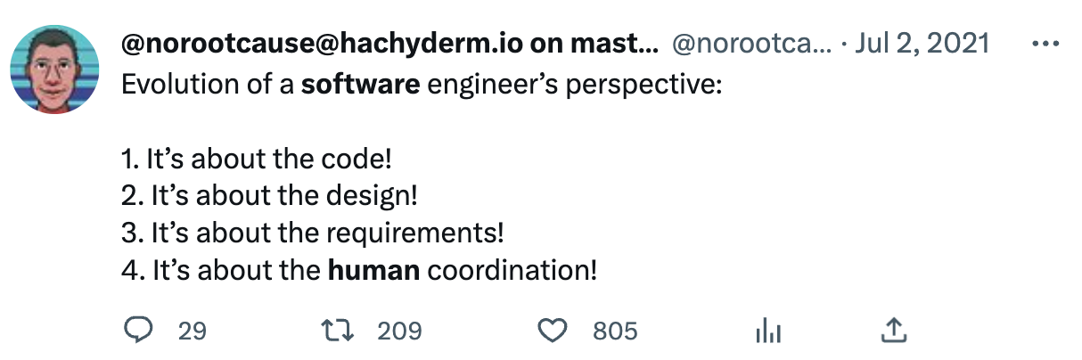
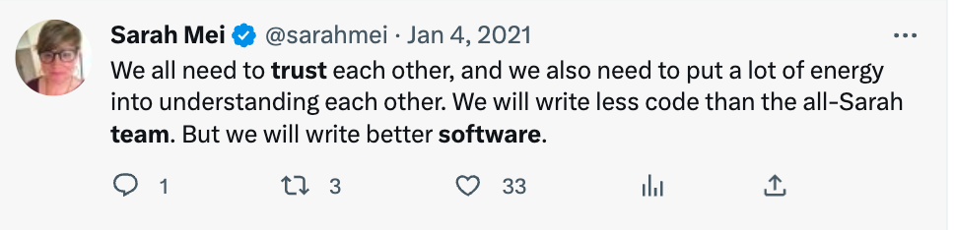
Trust and Coordination in SE

Slide 3
What is Trust?
Complex Psychological Concept!!
“the overall willingness of virtual team members to rely on one another that results from the aggregate of potential trust dimensions that are achieved through socio-emotional and task process and supported by technology capabilities”
- Mitchell & Zigurs, 2009

Slide 4






Dimensions of Trust: Factors that implicitly drive your decisions!
Action
Institutional
Commitment
Personality
Competence
Transferred

Slide 5


Preliminary Study
100 Pull Requests
Amirali Sajadi, Kostadin Damevski, and Pretha Chatterjee, “Interpersonal Trust in OSS: Exploring Dimensions of Trust in GitHub Pull Requests”, ICSE NIER, 2023

Slide 6
Dimensions of Trust in SE - Pull Requests (PR)
Action
Commitment
Competence
Institutional
Personality
Transferred
The frequency and quality of comments/reviews of PRs.
Reviewing PRs when requested or addressing a reviewer’s comment.
Developers’ past actions in the repository, their overall activity and status on GitHub.
Developers associated with the same organizations are more likely to trust each other.
Developers who accept a high number of PRs tend to have higher trust in others.
Well-established members can recommend the work of new contributors.
Amirali Sajadi, Kostadin Damevski, and Preetha Chatterjee, “Interpersonal Trust in OSS: Exploring Dimensions of Trust in GitHub Pull Requests”, ICSE NIER, 2023

Slide 7
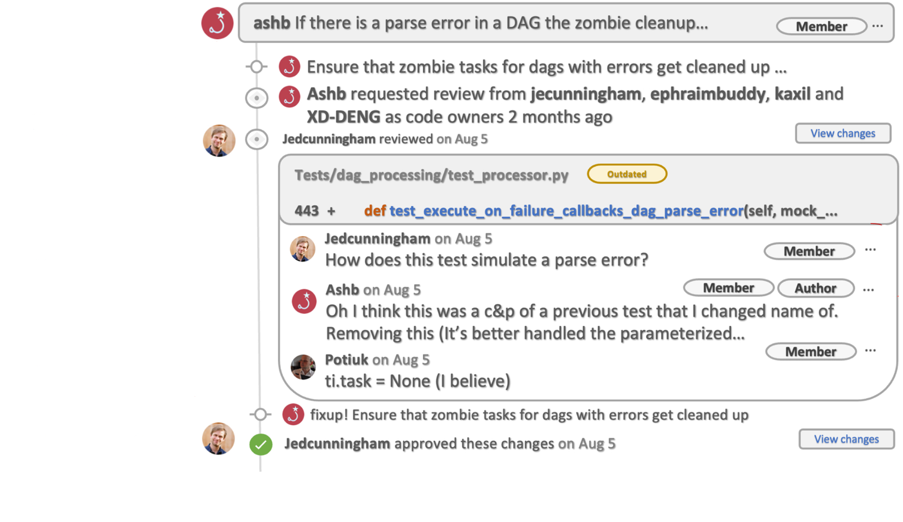
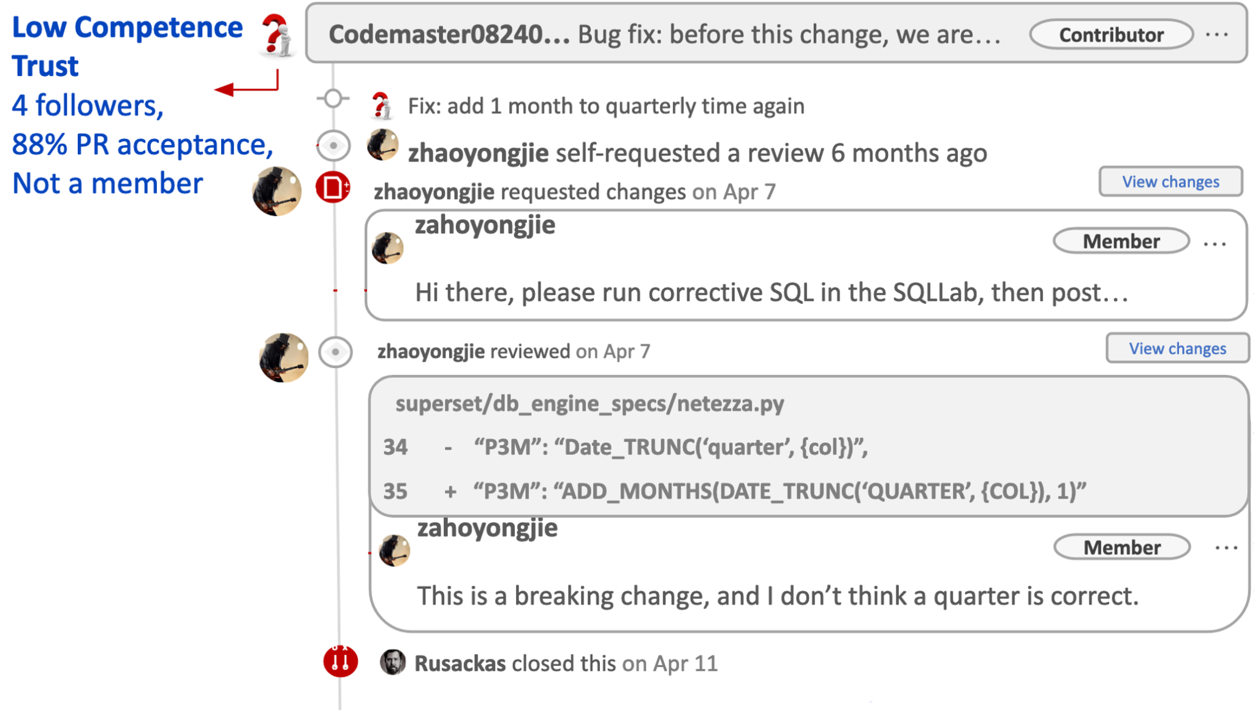
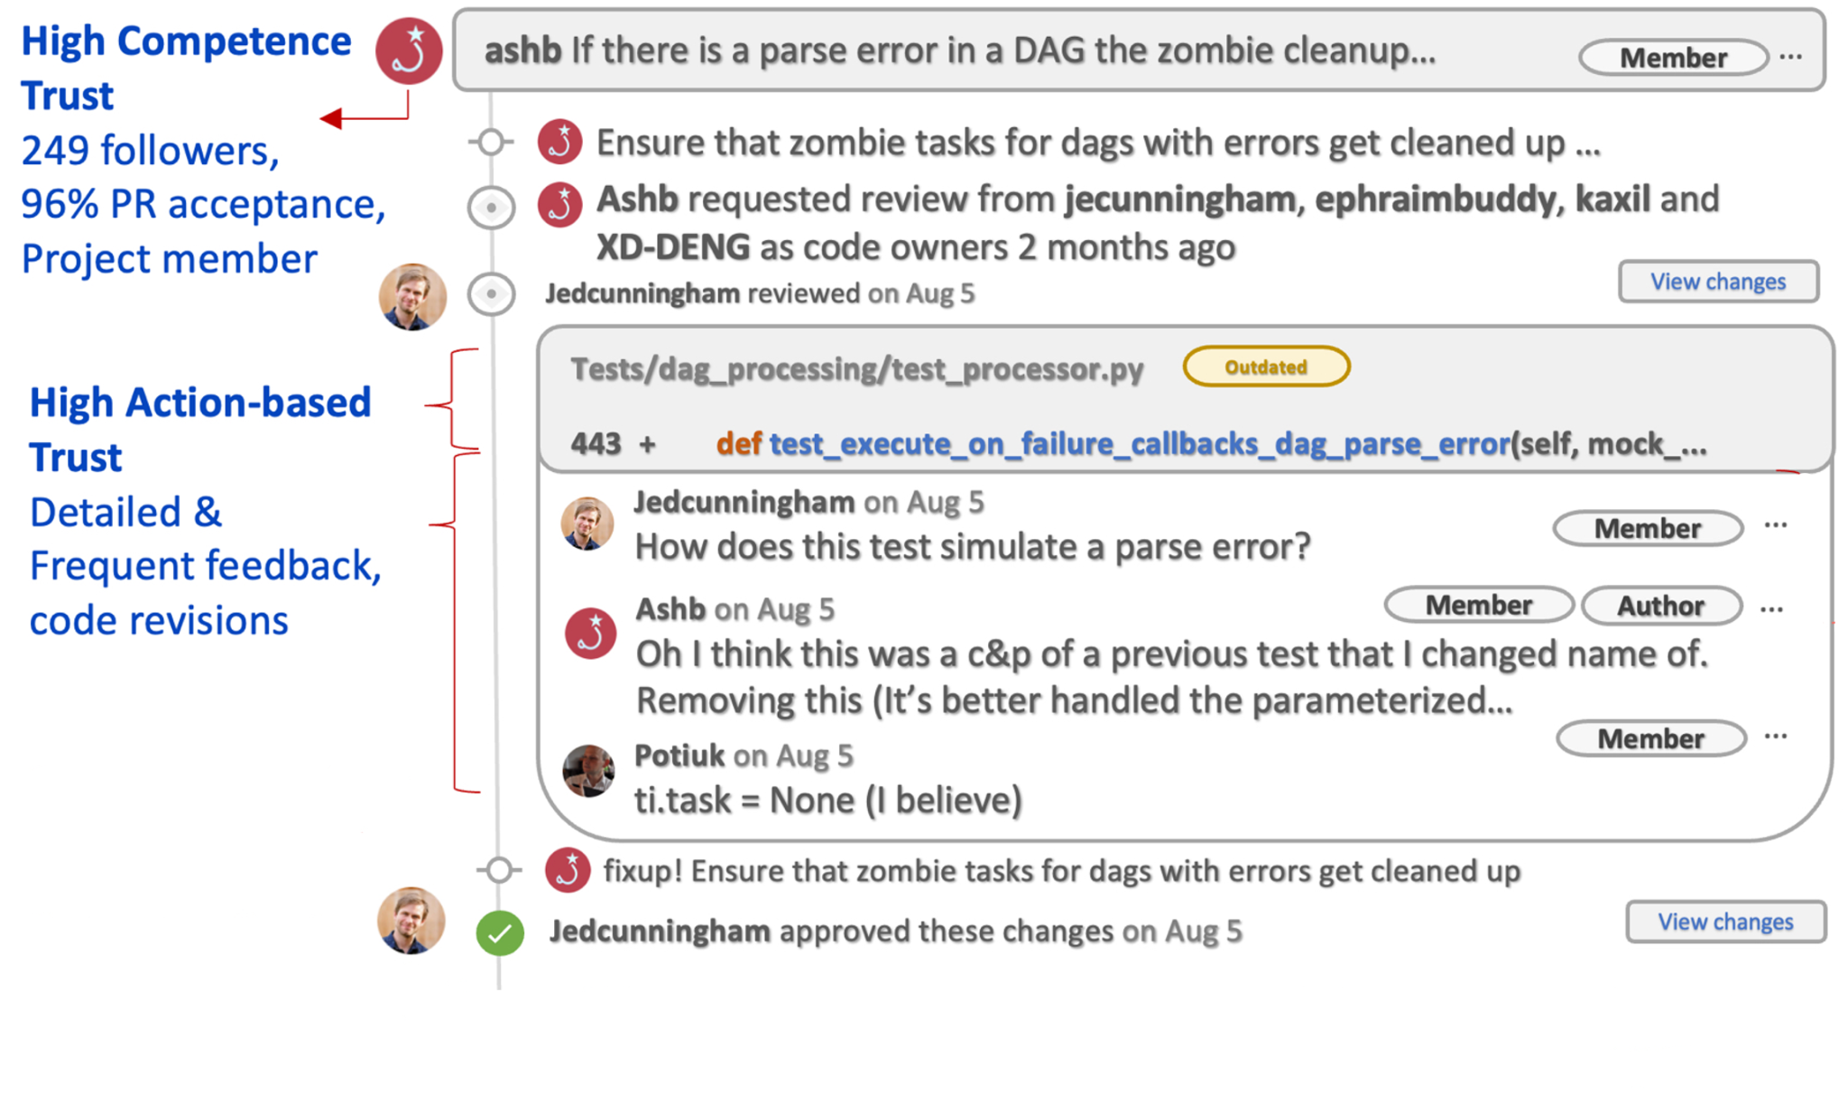
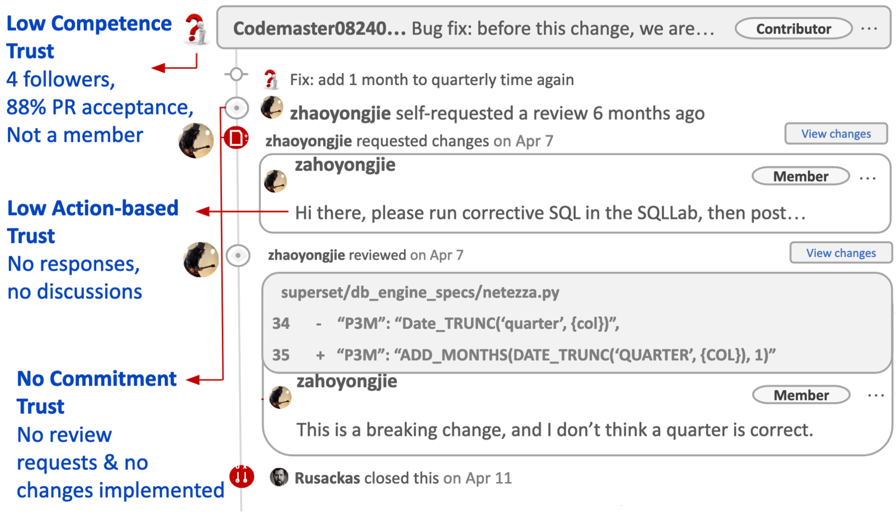
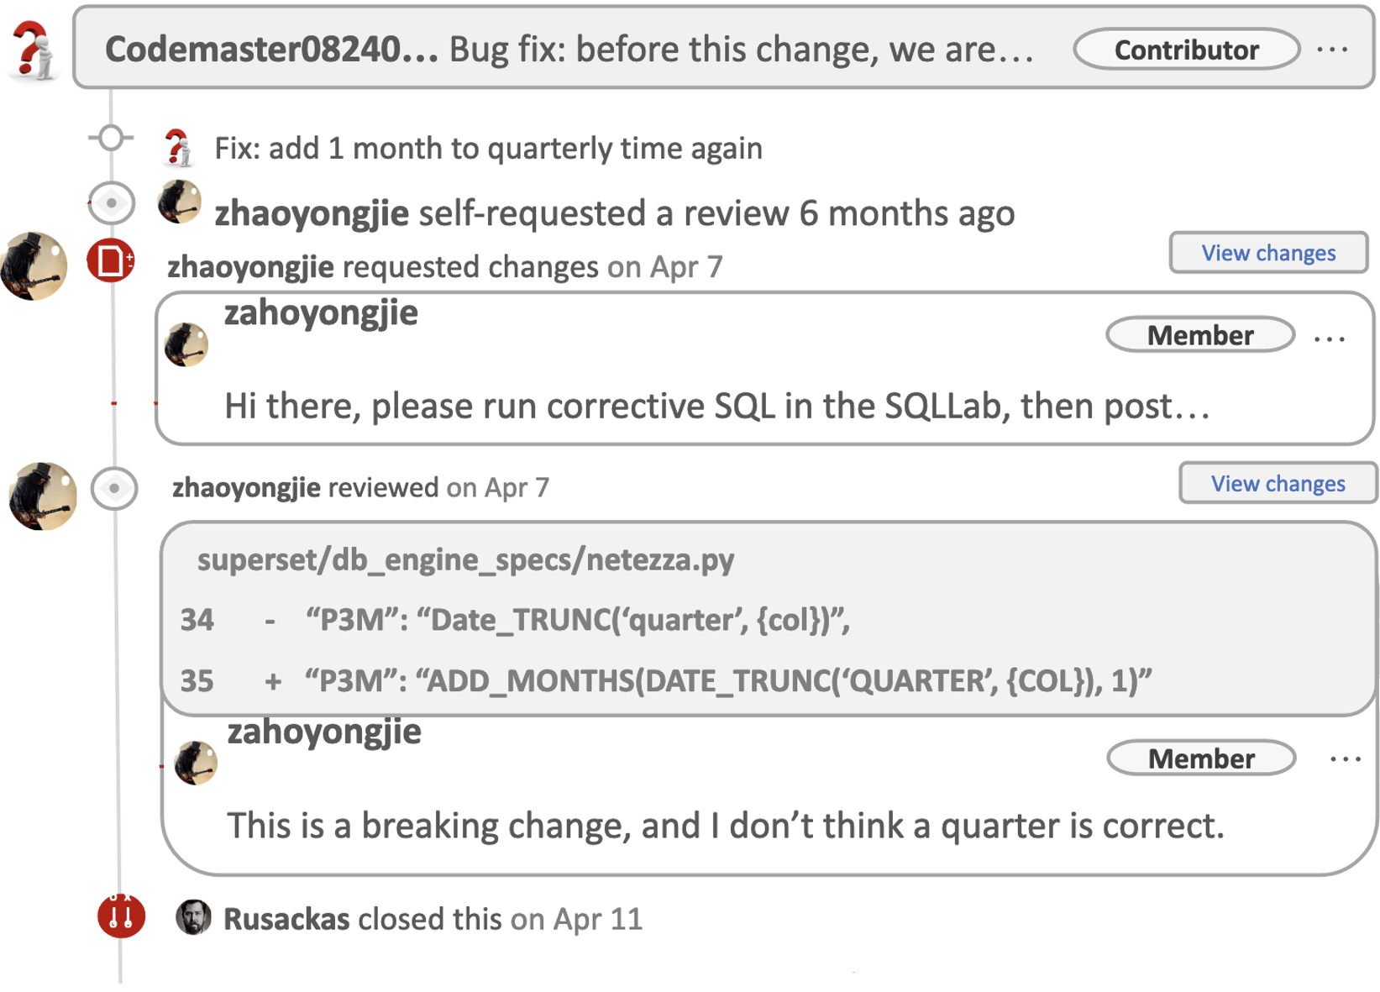
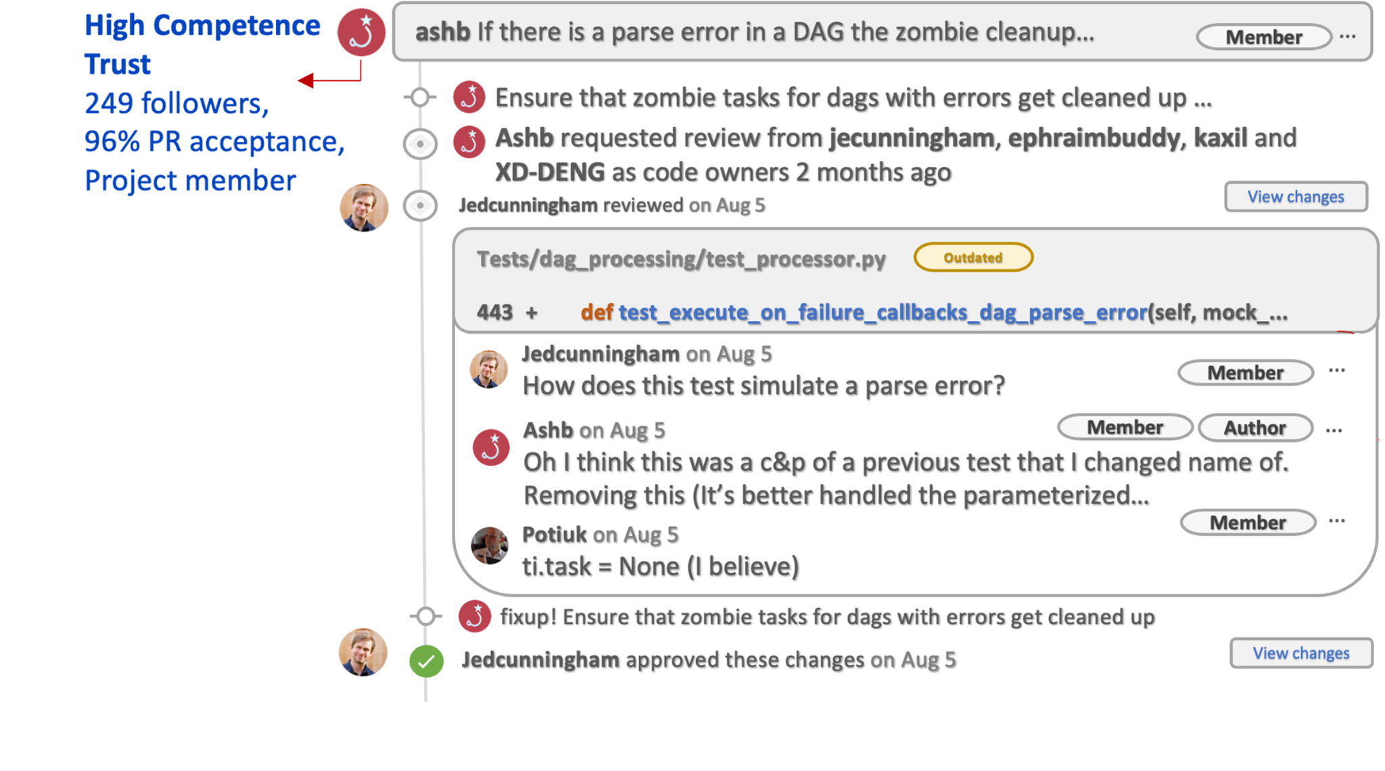
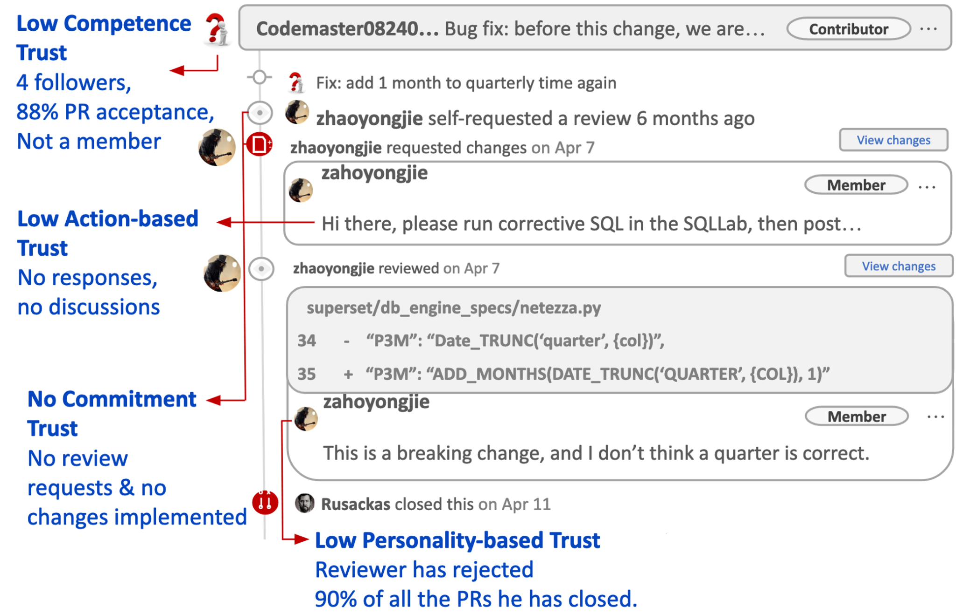
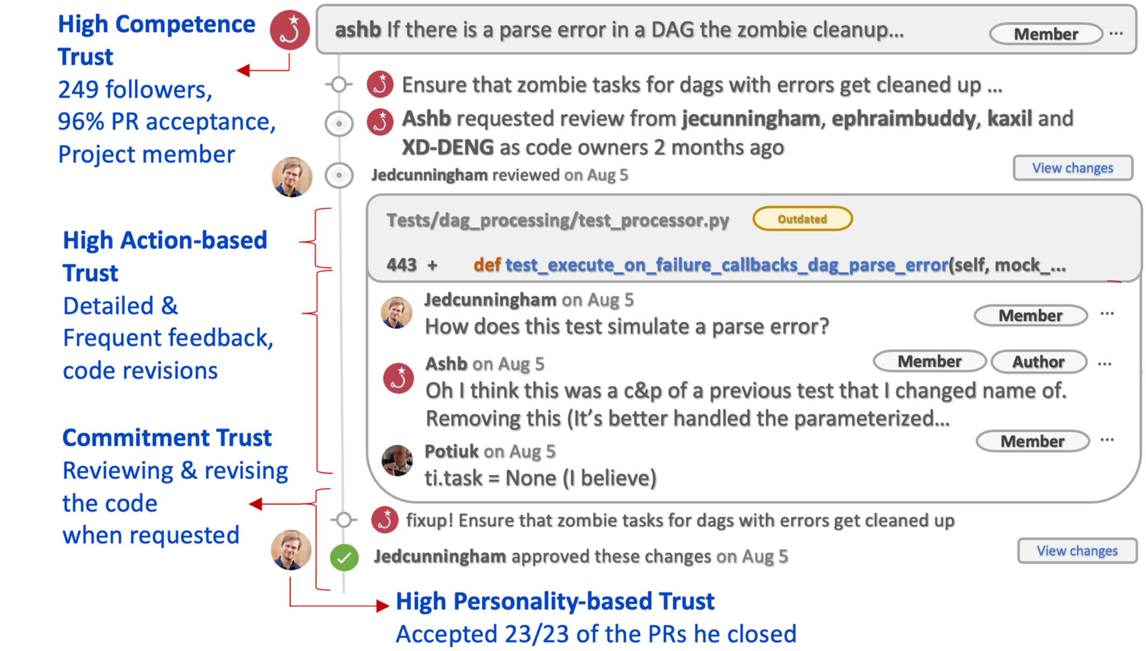
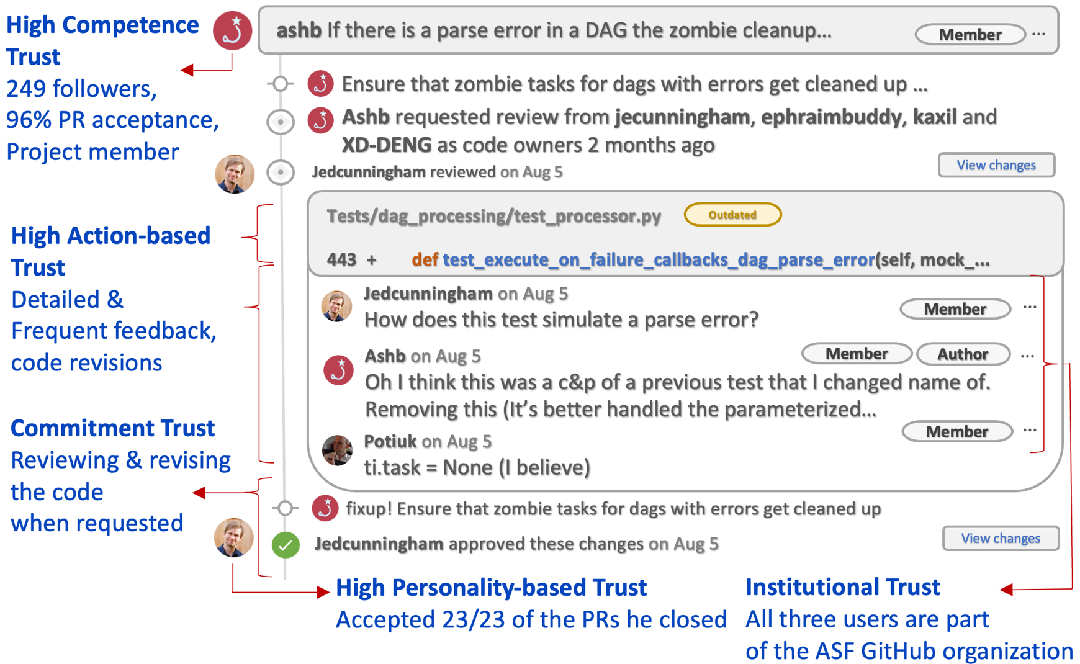
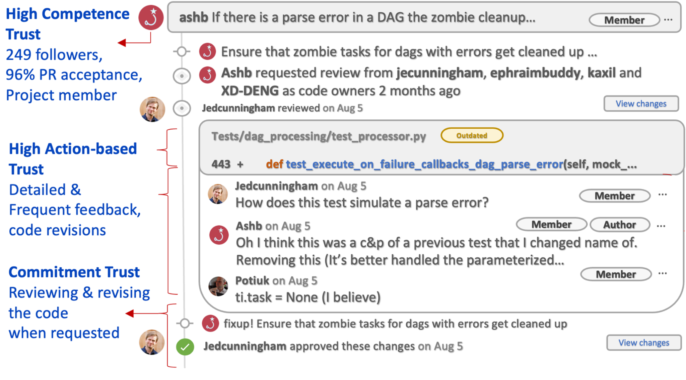
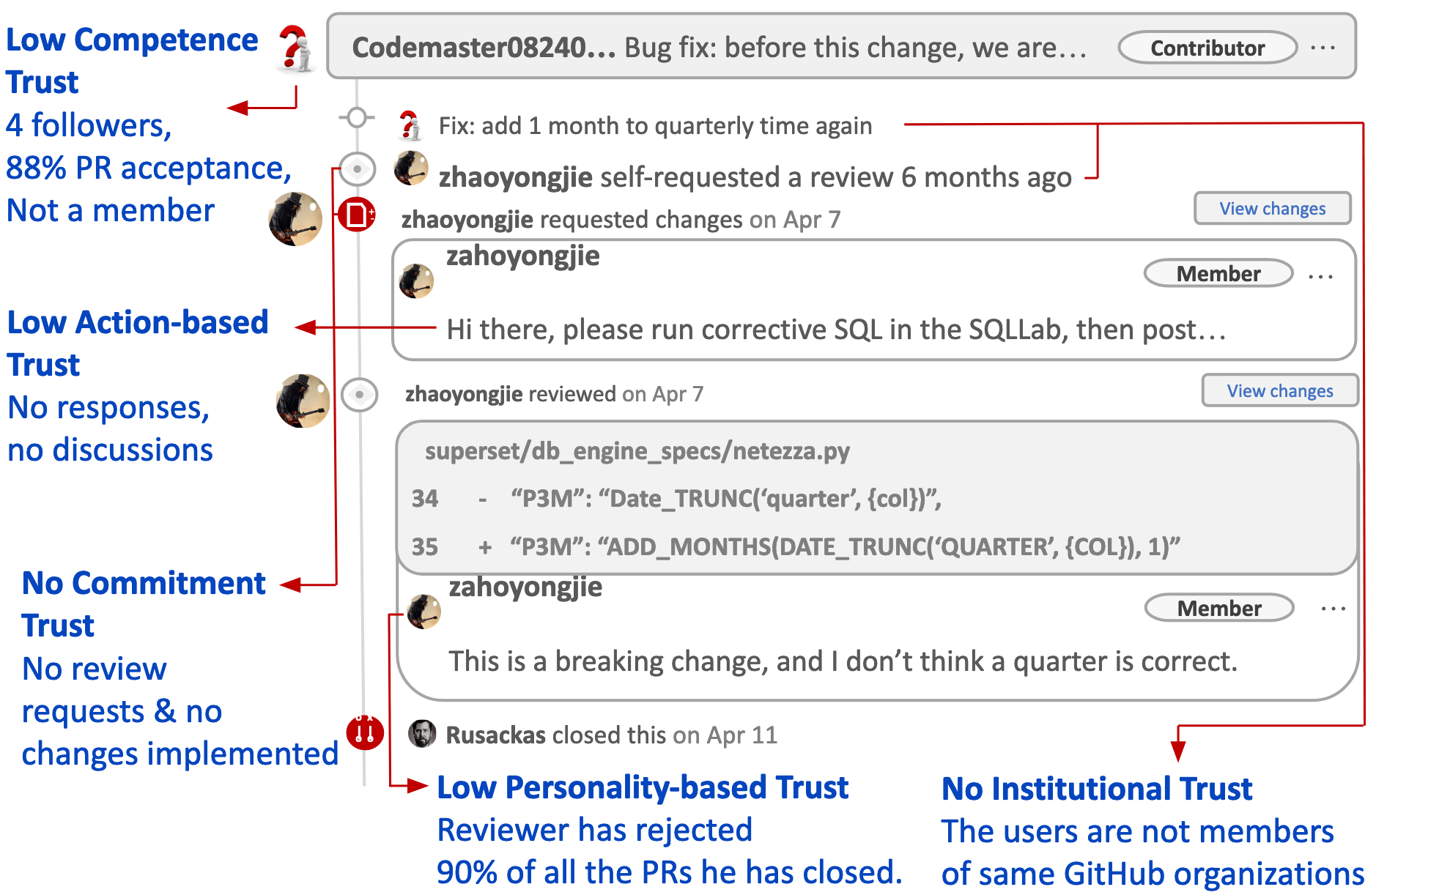
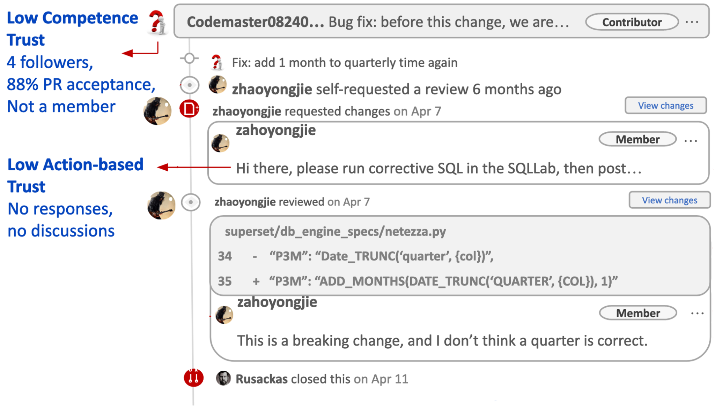
Trust in Pull Requests
Pull request interaction with high levels of trust Pull request interaction with high levels of trust
Amirali Sajadi, Kostadin Damevski, and Preetha Chatterjee, “Interpersonal Trust in OSS: Exploring Dimensions of Trust in GitHub Pull Requests”, ICSE NIER, 2023

Slide 8
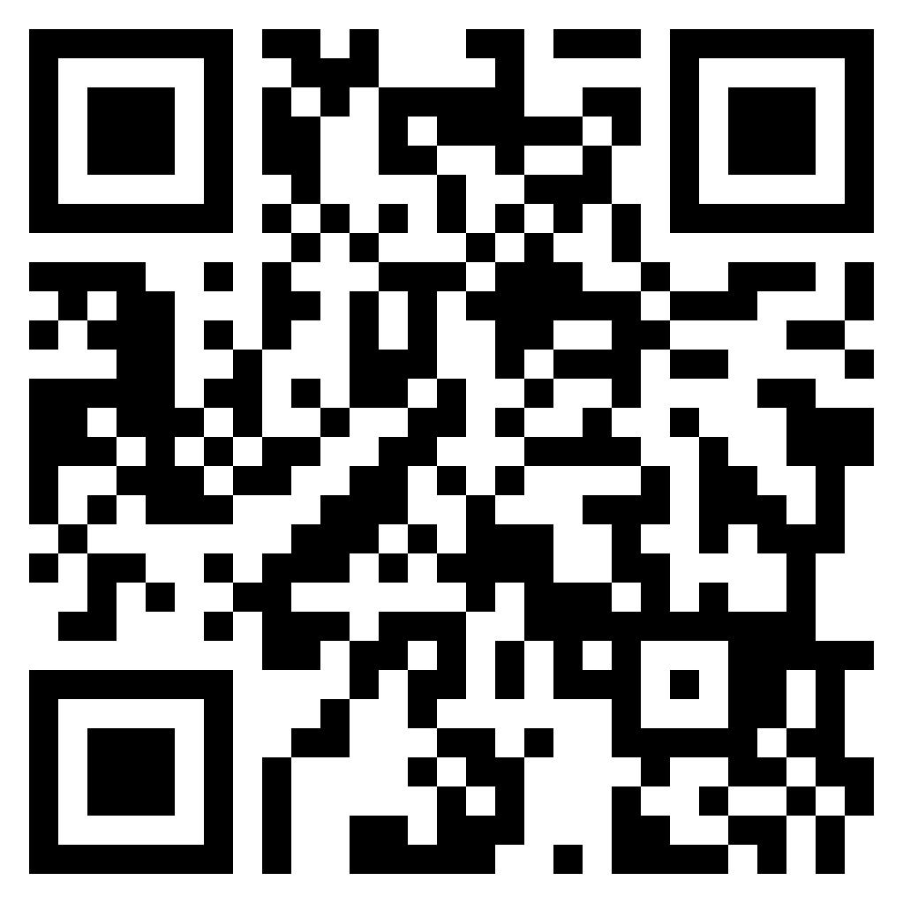
Implications
Examine what you trust, and how you trust!! This can help you identify risks in your collaboration.
Identifying and speaking frankly about our trust levels can help in improving team collaboration and communication
Understanding team dynamics in terms of these trust dimensions can aid project managers in timely interventions
Practitioners can focus on transparent communication, and regular feedback along these specific trust dimensions to build and maintain trust.
Thanks to my co-authors: Amirali Sajadi, Kostadin Damevski!
Preprint: https://preethac.github.io/files/ICSE_NIER_2023.pdf Dataset: https://tinyurl.com/2v77k4hv

